Slide 1
Dynamic Population Discovery for Lateral Movement Detection
Rod Sotto & Joseph Zadeh
Splunk UBA Team

Slide 2
introduction

Slide 3
$Whoami…
- Joseph Zadeh
Senior Data Scientist with Splunk User Behavioral Analytics.
Rod Soto
Senior Security Researcher with Splunk User Behavioral Analytics.

Slide 4
Outline
What is lateral movement? – Rod
Process, Objective & Tools used for lateral move - Rod
Why is lateral movement detection important? - Rod
What are behavioral profiles? What does it apply to? - Joe
How do we establish assets (current available technologies) – Rod - Joe
The importance of asset management – Rod - Joe
Combination of assets classes to establish behavioral profiles and risk - Joe
How can we automate discovery and data aggregation of DMZ assets - Joe
Proof of Concept / Example – Joe - Rod
Explanation of data science tools and techniques used for analysis – Joe
How can this be applied to layer 4/7 data or PCAP data - Joe
Conclusion - Rod - Joe

Slide 5
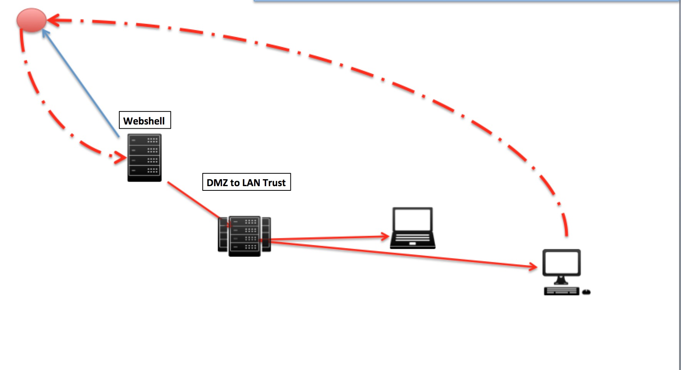
What is Lateral Movement?
Lateral movement are series of actions conducted after a successful exploitation attack or infiltration in a organization’s network that seeks to further reconnaissance and expand reach of attacker by gaining knowledge of internal network assets and accessing them.

Slide 6
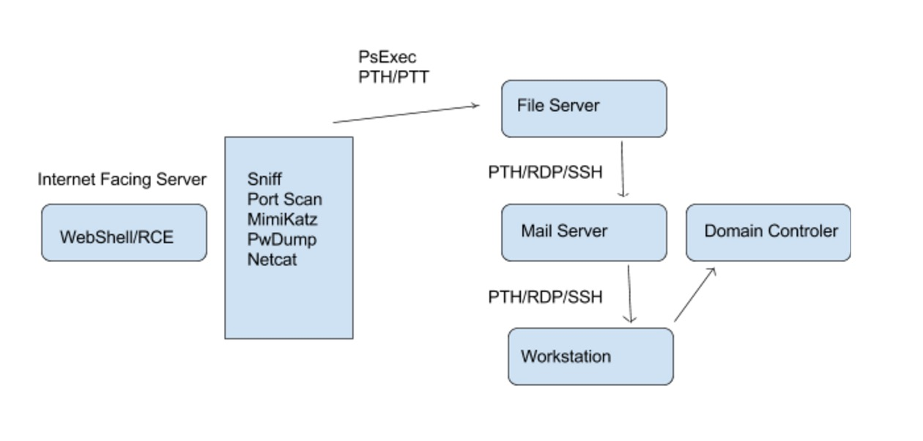
Lateral Movement process Example

Slide 7
Objectives
Main objectives of lateral move are:
- Gain further knowledge of internal network assets.
- Expand access into other systems
Ultimate goal is to get “Crown Jewels” which may be AD Domain admin credentials or access to valuable, sensitive information.

Slide 8
Tools
Some of the tools used for lateral movement include:
- Keyloggers, ARP spoofing, PwDump, Mimikatz
- PsExec, WMI, PowerShell, Metasploit, sc, at, wmic, reg, winrs
- RDP, SSH, VNC
- Exploits (PTH/PTT), BruteForce tools

Slide 9
Why is lateral movement detection important?
Let’s talk about the concept of DWELL, or Detection Deficit (VZN)
Rapid detection of lateral movement can reduce, contain and prevent further impact of a breach
Detection of lateral move enables SOC/SECOPS/IR/DR teams to act in a more efficient manner
Increases cost/deters attackers and would be external attackers, as well as insiders

Slide 10
How do we establish assets (current available technologies)
“In information security, computer security and network security an Asset is any data,device, or other component of the environment that supports information-related activities. Assets generally include hardware (e.g. servers and switches), software (e.g. mission critical applications and support systems) and confidential information.[1][2] Assets should be protected from illicit access, use, disclosure, alteration, destruction, and/or theft, resulting in loss to the organization.” *Wikipedia
Anything that is network enabled inside the perimeter should be consider an asset, most common assets are: Network servers, Routers, Switches, Databases, Application Servers, Workstations, Printers, IoTs.

Slide 11
The Importance of Asset Management
No asset management = No risk analysis
Unmonitored unsupervised assets are likely to be targeted and exploited by attackers.
Lack of OS/Application version/patch level increases risk of compromise
Enables access management to resources inside the perimeter
Enables SECOPS/IR/DS to identify and assess resources in case of incident

Slide 12
Practical ML for Security
Use the right tools for the job

Slide 13
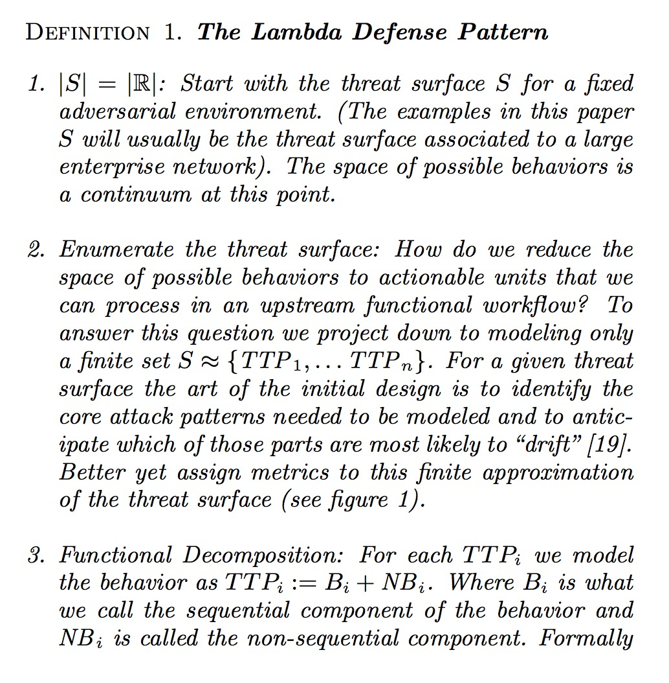
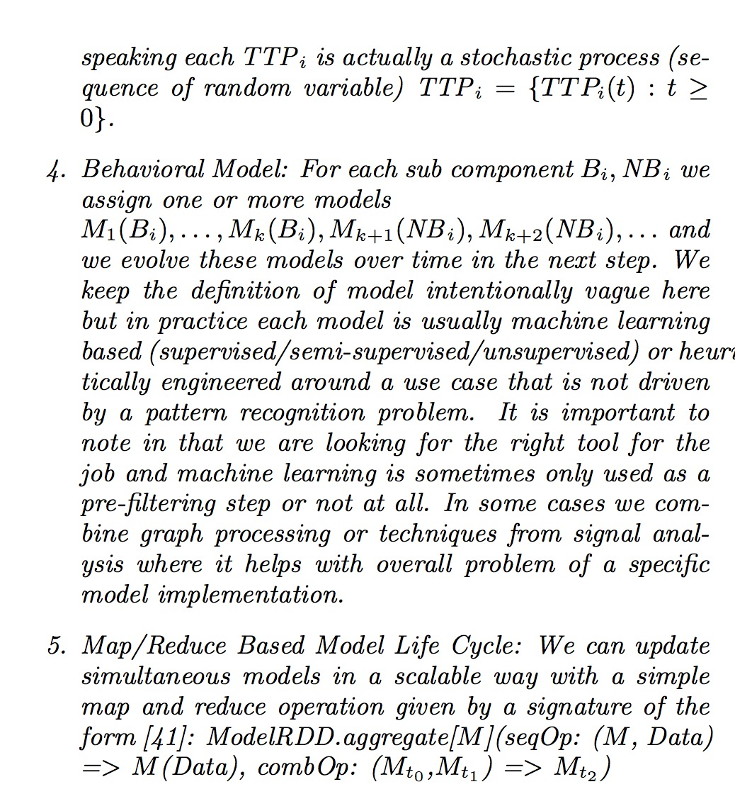
Decomposing Behaviors for Intrusion Detection

Slide 14
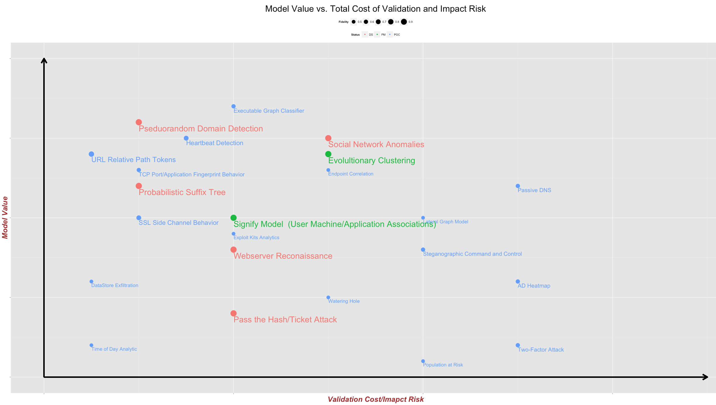


Cybersecurity Analytics: ROIv1
WAN
LAN

Slide 15
Behaviors: Sequential + “Unordered”
Sequential Behaviors
Exploit Chains
Timing Analysis (Periodicity)
Active Directory Sequence
Authentication Graph
Non Sequential Behaviors
Fingerprinting
Grouping Behaviors
Application Counts
Rare file extension counts for Webshell detection

Slide 16
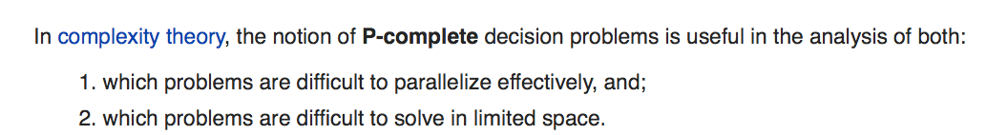
Mapping Behaviors to Code
Easy to Parallelize
Count()
Average()
Time series()
Local state computations
Per user/IP/account/…
Hard to Parallelize (NC Complete Complexity)
Rank()
Median
…
Anything that keeps track of global state
Notes:
The Complexity Class P-Complete and NC
NC => parallelizable
Some problems don’t parallelize well!!
P-Complete => Inherently Sequential
Any problem where you have to maintain state across nodes: Circuit Value Problem, Linear programming
Streaming models are usually harder to maintain than batch models

Slide 17
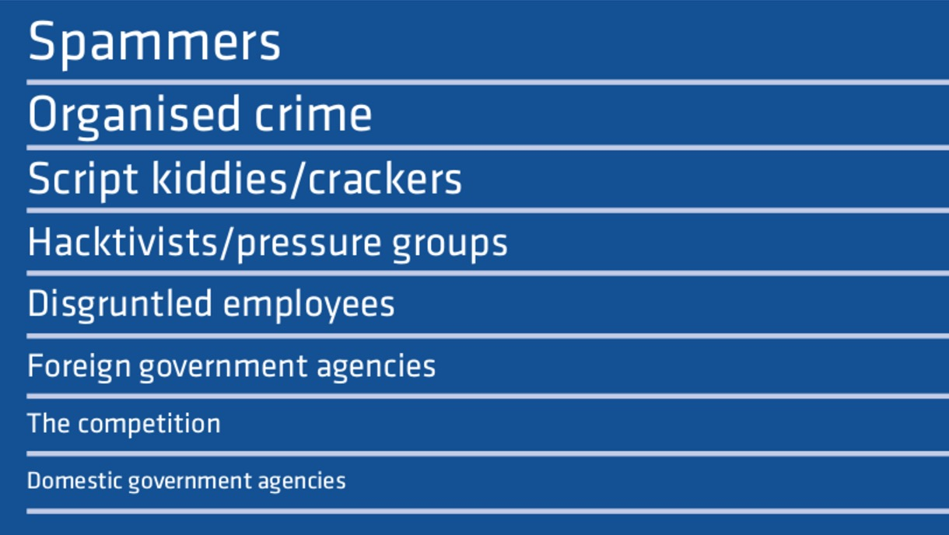
Adversarial Drift
Current status quo, is driven by adversaries developing and introducing changes in their TTPs, bypassing all current detection technologies.
Notes:
Rod

Slide 18
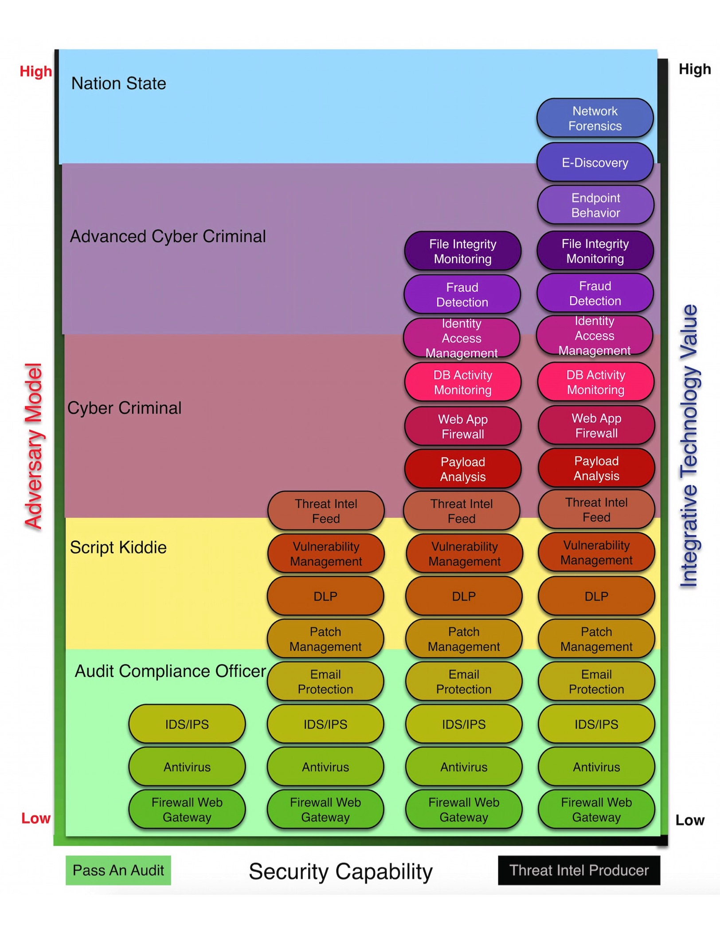
Advesarial Models
Machine Learning Looses Effectiveness the more complex the adversary

Slide 19
Advesarial Models
Non-Automatable Actions: Hybrid Human/Computer Analysis
Automatable Actions: Good for ML

Slide 20
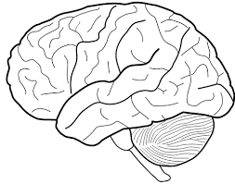
Learning = Compression?
There is a duality between learning and compression
Learning Machine
Primary Key | Time | UserID | Count
Row 1 | … | … | …
Row 2 | … | … | …
Row 3 | … | … | …
… | … | … | …
Row N | … | … | …
C1 | C2 | C3 | C4 | C5
Learned output is a set of “coefficients”
Total Output Size = 1K
Input Data Total Size = 1 GB

Slide 21
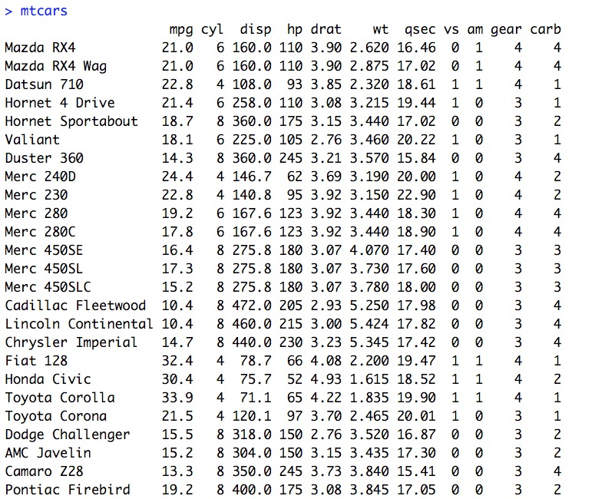
Learning = Compression?
Example of Linear Regression in R
Learning Machine: R Linear Model

Slide 22
Learning = Compression?
Train a model to predict mpg as a function of car weight, number of cylinders and displacement
Learning Machine: R Linear Model

Slide 23
Learning = Compression?
Train a model to predict mpg as a function of car weight, number of cylinders and displacement
Learning Machine: R Linear Model

Slide 24
Learning = Compression?
The overall input data is reduced in a “compressed form” to use in future predictions
Learning Machine: R Linear Model

Slide 25
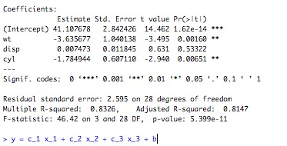
Learning = Compression?
This process is extremely brittle in terms of modeling a changing signal or an adversary that changes patterns over time
Learning Machine: R Linear Model

Slide 26
Learning = Compression?
The simple linear model gives us output that separates the Signal from the Noise (this is not always possible with a model)
Learning Machine: R Linear Model

Slide 27
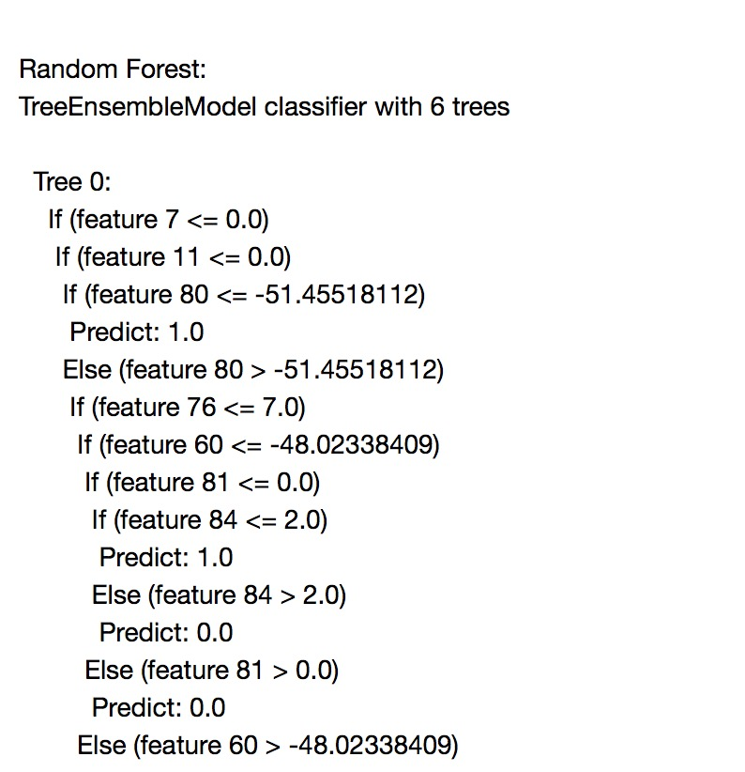
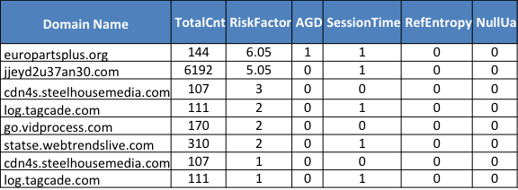
Learning = Compression?
Real example of random forest trained on C2 traffic
Learning Machine: MLLib Random Forest

Slide 28
Learning = Compression?
We really “learn” a function we can call in batch or real time

Slide 29
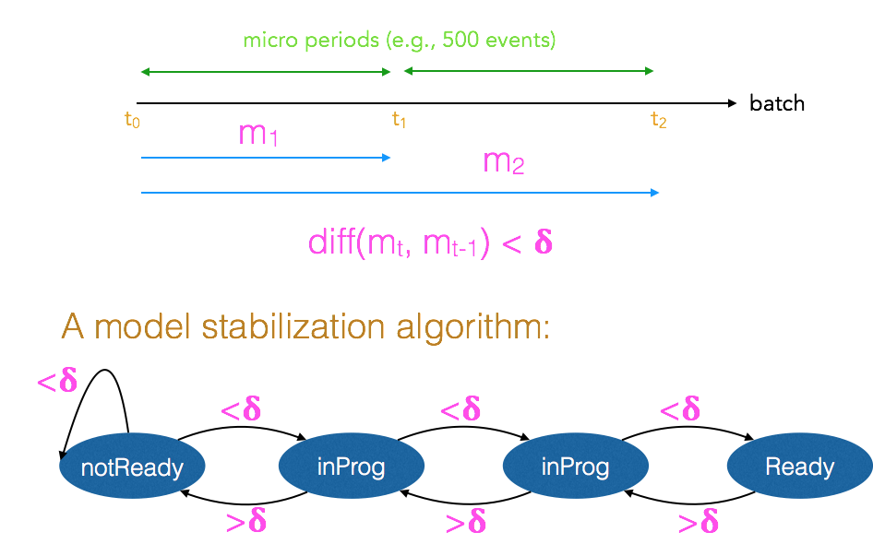
When is a model ready?

Slide 30
Security Analytics for defense
“But all too often we forget the first rule of battle - the battlefield – the attacker can escape everything it cannot escape the terrain – choose the terrain, use the terrain – we win” Sun Tzu
Notes:
Great another Sun Tzu quote at a security talk! ;-)
Be the Floyd Maywheather of defense I want you to know what I am going to be able to do but still be able to defend
Open source tactics
Security is bullshit in terms of closed form defensive solutions lets change that paradigm

Slide 31
High Level Objectives
Asset Class Discovery
Identify all things acting like device type “X”
Identify key services/assets in the DMZ
Identify human / non human by device
Anomalies on rare paths
U->S
S->U
U->U (LAN to LAN)
S->S (DMZ to LAN)
Identity Resolution Impossible Mappings

Slide 32
Modeling Methodology
Step 1: Identity Resolution
Step 2: Topology Discovery
Step 3: Behavioral Profiles
Step 4: Client/Server Relationship Discovery
Step 5: Monitor for changes in asset relationship graph

Slide 33
Asset/Service Dynamic Discovery
Spark Data Frame
Raw Data
Identity Resolution
Learn DMZ Assets
Fixed Services Discovery: FTP, HTTP
Pull in Other Data (Beacons/Fingerprint)
Mapping Anomalies
Human Fingerprint
Anomalies: U->S, S->U, U->U (LAN to LAN), S->S (DMZ to LAN)

Slide 34
Asset/Service Dynamic Discovery
Semi Aggregates
MAC | R2L | L2L | L2R | R2R | Total Cnt
00:AA:00:BB:AA | 0% | 90% | 10% | 0%
MAC/IP | Application Distribution (Dynamic) |  | Fixed Apps |  | Port/Protocol Distribution
 | Dynamic Counts |  | Windows Update | Java | Dynamic Counts
00:AA:00:BB:AA |  |  | 5% | 20%
Device (MAC/IP) | Domain Distribution (layer 7) |  | IP Distribution (layer 4) |  | Num of Unique External/Internal Devices | Weekly Access Heatmap
 | Dynamic Counts |  | Dynamic Counts
00:AA:00:BB:AA
IP | Fixed Event IDs (possibly can just use Meis model here)
10.10.0.1
MAC | Identity Resolution Checks
 | IP | Cnt | NodeDegree
00:AA:00:BB:AA | 10.10.0.1
IP | Identity Resolution Checks
10.10.0.1 | 00:AA:00:BB:AA
MAC | Time resolution roll ups
00:AA:00:BB:AA
Device | Top 10 Apps |  | Top 10 domains
 | Dynamic Counts
10.10.0.1

Slide 35
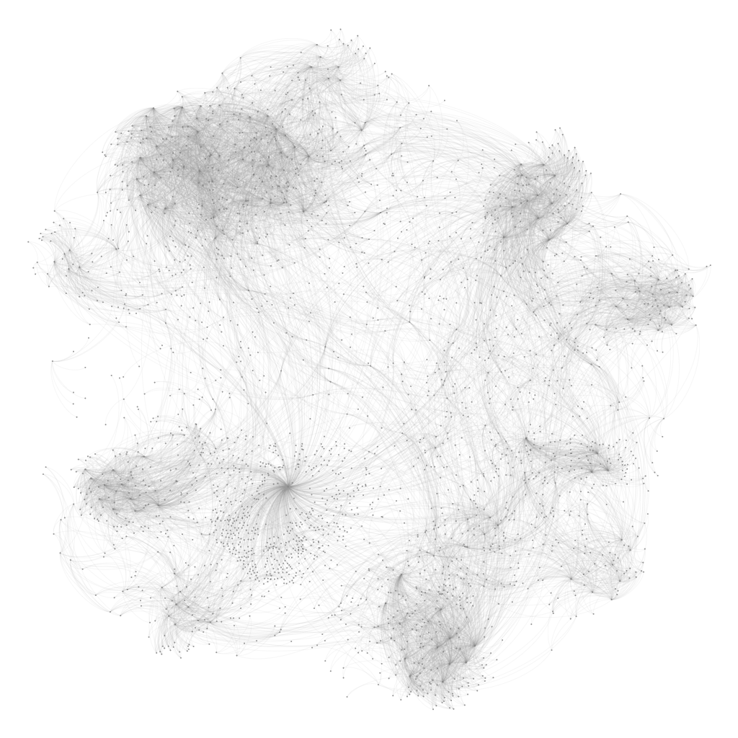
Seeing the Analytic In Action

Slide 36
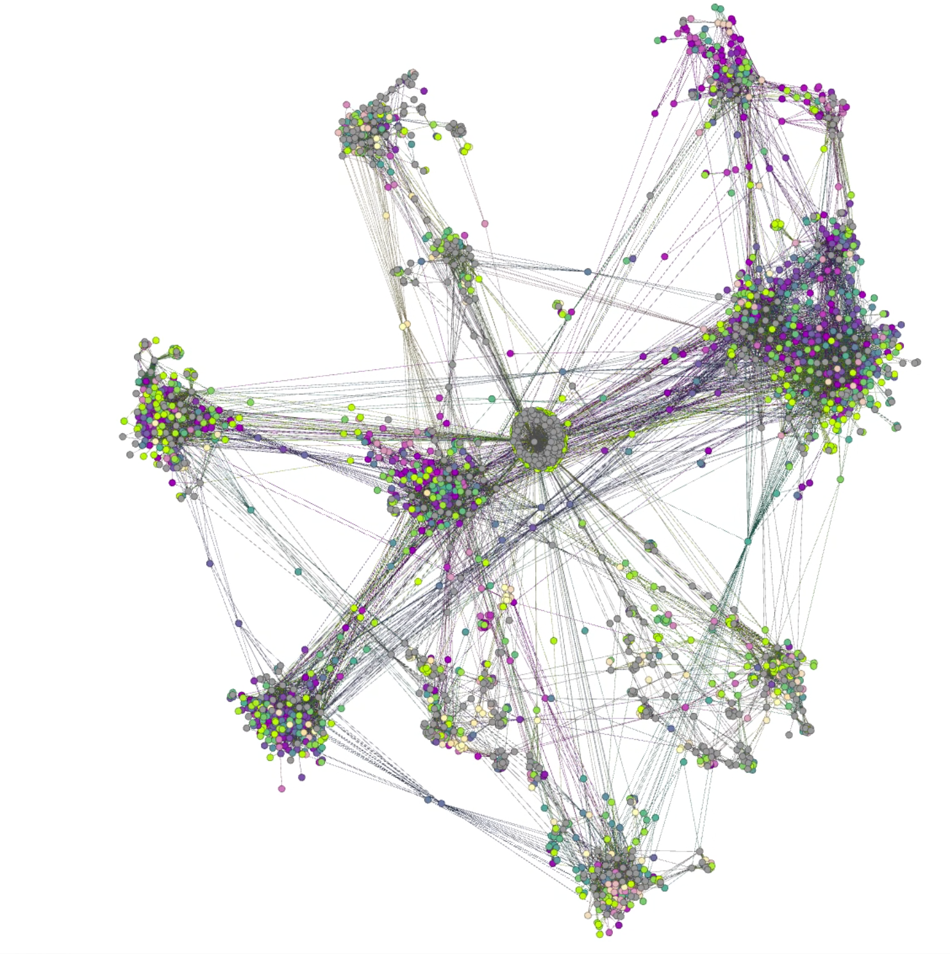
Seeing the Analytic In Action

Slide 37
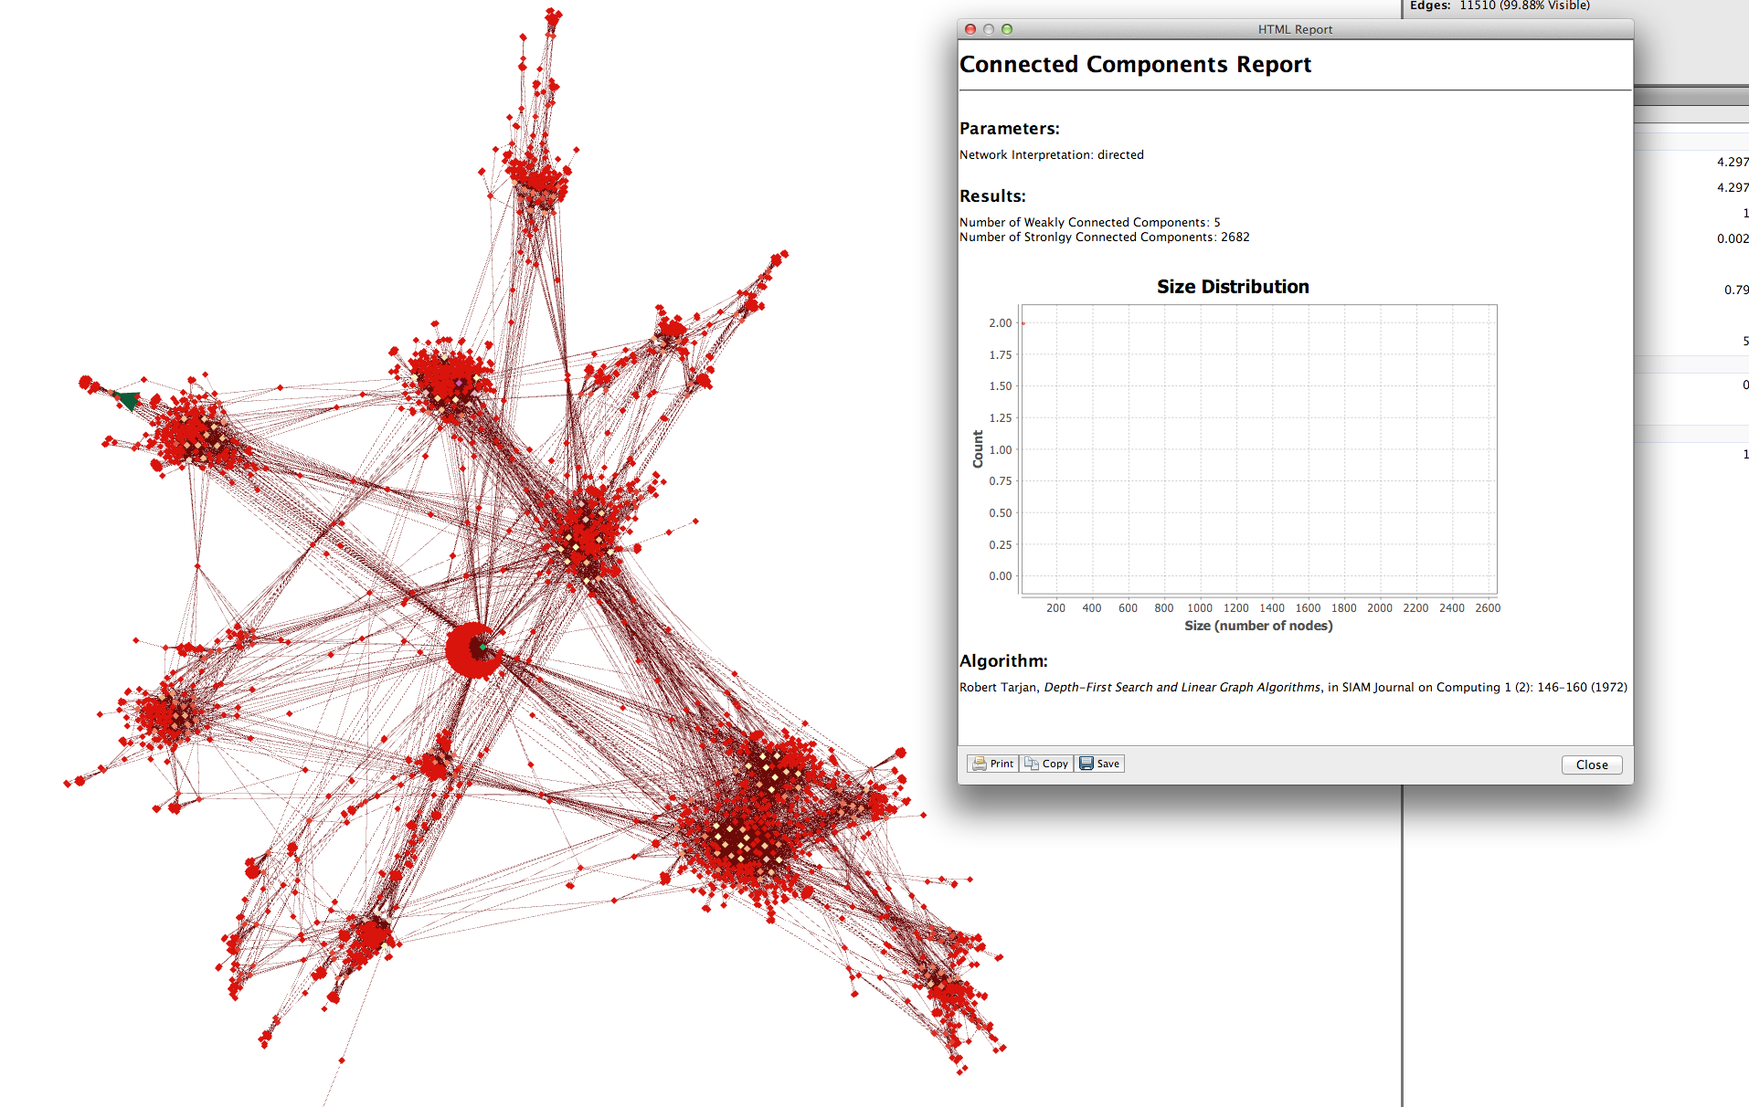
Seeing the Analytic In Action
Once identity resolution/learning process is complete we create new anomalies based on new paths/actions that are rare for a particular population profiel
Lightweight Webshell in the DMZ

Slide 38
STEP1: IDENTITY RESOLUTION
GARBAGE IN GARBAGE OUT

Slide 39
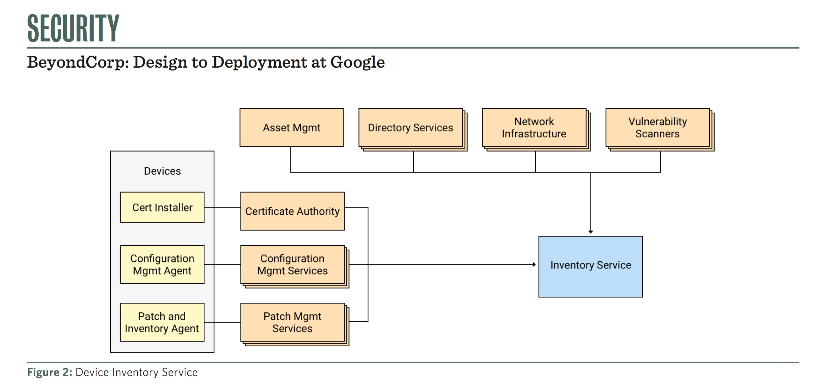
Identity Resolution
Many possible ways to attack the identity resolution problem with enterprise solutions but this usually has complexity
Smaller scale shops should leverage work already done here - SIEM is a good example a tool that normalizes lots of these scenarios
Advanced Pattern – Inventory Based Trust : Usenix 2016 “BeyondCorp: Design to Deployment at Google”

Slide 40
ID Resolution WORKFLOW
DHCP
DHCP State Table
Active ID Table
IMS State Table
IMS/IPAM
ID Res Event ID Filter
AD State Table
Similar to SQL’s Coallase:
Username = select coallesce(user_name, hostname, IP) from Active_ID_Table where IP = ‘10.10.100.23)
AD
Duplicate Streams
Identity Annotator /
Normalization Engine
FW
Algorithms
Proxy
VPN

Slide 41
ETL Online Mode: Raw Individual Streams
DHCP
DHCP State Table
Active ID Table
IMS State Table
IMS/IPAM
ID Res Event ID Filter
AD State Table
AD
Incremental load: Prioritizing updates to state table in real time
Assign priority to data streams for automated ETL of daily/weekly/incremental updates
Update Active ID Table before any other workflow task begins
FW
Proxy
VPN

Slide 42
ETL Online Mode: Raw Individual Streams
IP_Address | Hostname | MAC | LastLease_Timestamp
10.10.50.25 | dave.eng.acme.com | 58:5c:35:c3:6e:a4 | 2014-03-10T13:00:00
10.10.50.25 | dave.eng.acme.com | 58:5c:35:c3:6e:a4 | 2014-03-10T14:00:00
10.10.50.25 | dave.eng.acme.com | 58:5c:35:c3:6e:a4 | 2014-03-10T22:30:00
10.10.50.25 | dave.eng.acme.com | 58:5c:35:c3:6e:a4 | 2014-03-11T09:00:00
10.100.1.23 | dave.eng.acme.com | 58:5c:35:c3:6e:a4 | 2014-03-11T14:00:00
10.5.12.2 | scott.hr.acme.com | 12:3a:74:b2:6a:22 | 2014-03-10T10:00:00
10.5.12.2 | scott.hr.acme.com | 12:3a:74:b2:6a:22 | 2014-03-10T14:30:00
192.168.1.65 | scott.hr.acme.com | 00:50:a6:d2:21:01 | 2014-03-10T14:30:00
10.5.12.2 | scott.hr.acme.com | 12:3a:74:b2:6a:22 | 2014-03-10T17:30:00
192.168.1.65 | scott.hr.acme.com | 1b:31:a5:1d:b0:11 | 2014-03-11T14:50:00
10.13.11.221 | scott.hr.acme.com | 12:3a:74:b2:6a:22 | 2014-03-12T14:30:00
DHCP
DHCP State Table
1. Drop all tuples not containing Event ID = 673, EventID = 4663
2. ID data extractor for keeping only key data points necessary for AD State table
ID Res Event ID Filter
AD_IP | Username | FQDN | Event_Time
10.10.50.25 | dave | dave.eng.acme | 2014-03-10T13:00:00
10.10.50.25 | dave | dave.eng.acme | 2014-03-10T14:00:00
10.10.50.25 | dave | dave.eng.acme | 2014-03-11T09:00:00
10.100.1.23 | dave@acme.com |  | 2014-03-11T14:00:00
10.5.12.2 | scott | scott.hr.acme | 2014-03-10T10:00:00
192.168.1.65 | scott@acme.com |  | 2014-03-10T14:30:00
10.13.11.221 | scott |  | 2014-03-12T14:30:00
192.168.1.65 | scott | scott.hr.acme | 2014-03-11T14:50:00
AD State Table
AD

Slide 43
ETL Online Mode: Real Time Active State Table
IP_Address | Hostname | MAC | LastLease_Timestamp
10.10.50.25 | steve.eng.acme.com | 58:5c:35:c3:6e:a4 | 2014-03-10T13:00:00
10.10.50.25 | dave.eng.acme.com | 58:5c:35:c3:6e:a4 | 2014-03-10T14:00:00
10.10.50.25 | dave.eng.acme.com | 58:5c:35:c3:6e:a4 | 2014-03-10T22:30:00
10.10.50.25 | dave.eng.acme.com | 58:5c:35:c3:6e:a4 | 2014-03-11T09:00:00
10.100.1.23 | dave.eng.acme.com | 58:5c:35:c3:6e:a4 | 2014-03-11T14:00:00
10.5.12.2 | scott.hr.acme.com | 12:3a:74:b2:6a:22 | 2014-03-10T10:00:00
10.5.12.2 | scott.hr.acme.com | 12:3a:74:b2:6a:22 | 2014-03-10T14:30:00
192.168.1.65 | scott.hr.acme.com | 00:50:a6:d2:21:01 | 2014-03-10T14:30:00
10.5.12.2 | scott.hr.acme.com | 12:3a:74:b2:6a:22 | 2014-03-10T17:30:00
192.168.1.65 | scott.hr.acme.com | 1b:31:a5:1d:b0:11 | 2014-03-11T14:50:00
10.13.11.221 | scott.hr.acme.com | 12:3a:74:b2:6a:22 | 2014-03-12T14:30:00
AD_IP | Username | FQDN | Event_Time
10.10.50.25 | dave | dave.eng.acme | 2014-03-10T13:00:00
10.10.50.25 | dave | dave.eng.acme | 2014-03-10T14:00:00
10.10.50.25 | dave | dave.eng.acme | 2014-03-11T09:00:00
10.100.1.23 | dave@acme.com |  | 2014-03-11T14:00:00
10.5.12.2 | scott | scott.hr.acme | 2014-03-10T10:00:00
192.168.1.65 | scott@acme.com |  | 2014-03-10T14:30:00
10.13.11.221 | scott |  | 2014-03-12T14:30:00
192.168.1.65 | scot | scott.hr.acme | 2014-03-11T14:50:00
Real Time Identity Table
IP | DHCP.hostname | DHCP.MAC | DHCP_Lasteventtime | AD_username | AD_FQDN | AD_Lasteventtime
10.100.1.23 | dave.eng.acme.com | 58:5c:35:c3:6e:a4 | 2014-03-11T14:00:00 | dave@acme.com | dave.eng.acme.com | 2014-03-11T14:00:00
10.13.11.221 | scott.hr.acme.com | 12:3a:74:b2:6a:22 | 2014-03-12T14:30:00 | scott | scot.hr.acme.com | 2014-03-12T14:30:00
10.131.1.4 | admin | NULL | NULL | domain_admin | acme.com | 2014-03-12T23:00:00
Primary Key

Slide 44
STEP 2: Topology Discovery
Learning the Local Layers

Slide 45
Map the lower layers of the OSI model passively
Infer key properties
DMZ blocks (often times we find new segments this way)
LAN only blocks
VLAN behavior (Student VLAN, ADMIN VLAN, STAFF VLAN)
Keep in mind we loose visibility into switched traffic flows (layer 2 is hard to see at scale)

Slide 46
Basic Features Built in this Step
Graph Features
Source/Destination behavior
How many hosts talk to this IP? (In Degree)
How many hosts are talked to by this IP? (Out Degree)
Layer 2/Layer 3 Features
IP Subnet Behavior
# LAN to LAN conversations (non routable IP flows)
# LAN to WAN conversations (non routable address to routable routable address )

Slide 47
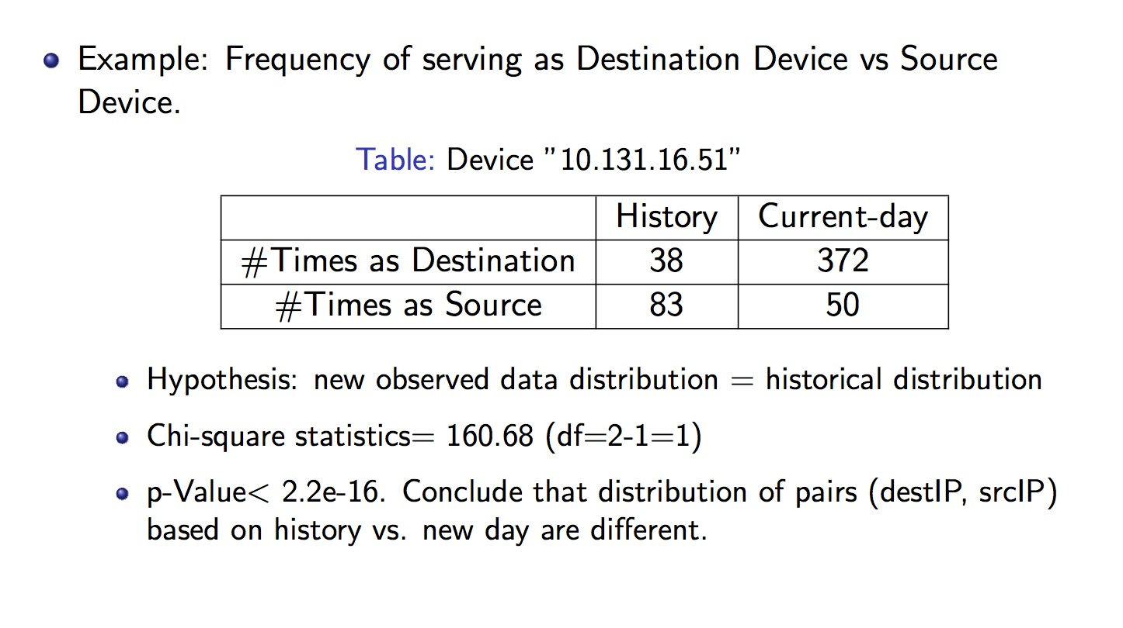
Graph Features: Example

Slide 48
STEP 3: Behavior based profiling

Slide 49


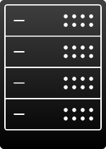




Asset Fingerprints
Goal is to use machine learning, vanilla/fuzzy correlation to discover some common asset classes (ML term sometimes is class labels)
Desktop
Laptop
MS Server
*nix Server
IOT
Biomedical
Devices
Energy Meters

Slide 50
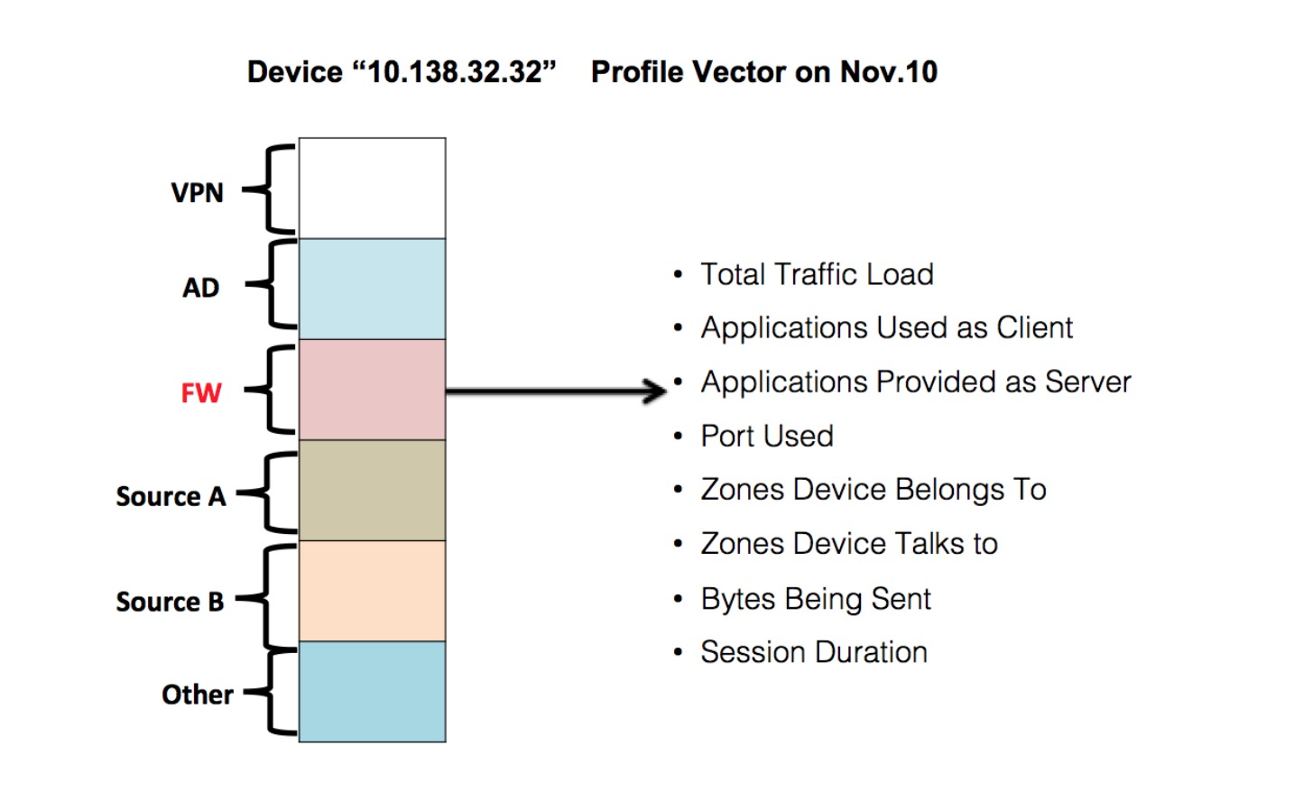
What are behavioral profiles? What does it apply to?
Windows 2008/2003 Server Profile
Flow Characteristics:
Byte distribution ratios are asymmetric
Application Layer Characteristics
SMB, Netbios MS-Update
Number of unique domains per day
Windows 2008/2003 End Device Profile
Flow Characteristics:
Application Layer Characteristics:
Facebook Chat, social media, twitter,
Non uniform browsing patterns
*nix Server/End Device Device Profile
Flow Characteristics:
Application Layer Characteristic
Software updates for distros (ubuntu, rhel)

Slide 51
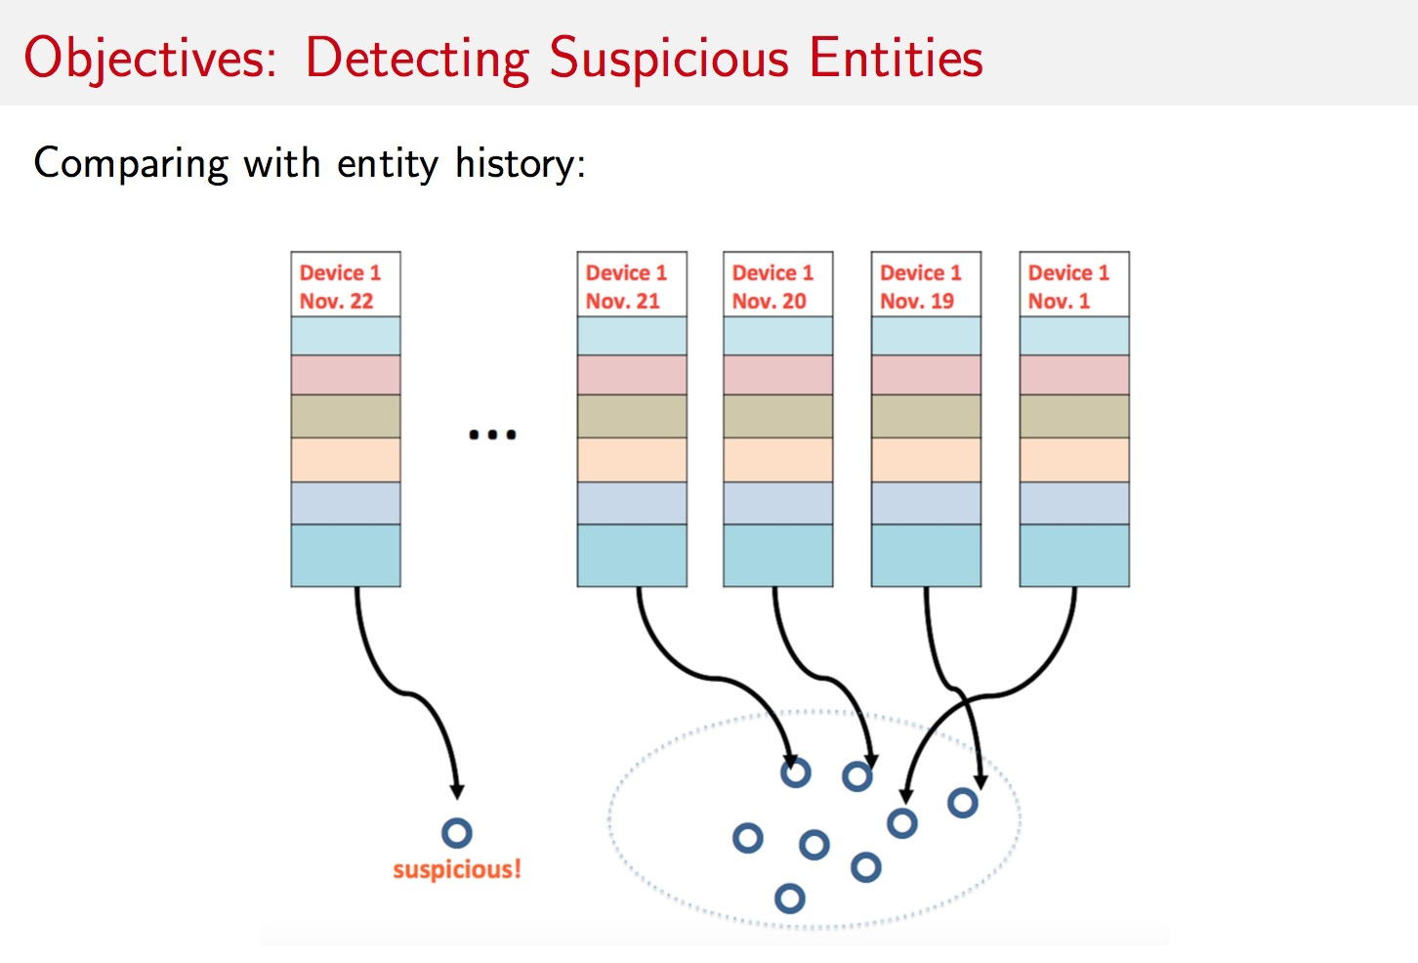
Representing a Profile Over Time

Slide 52
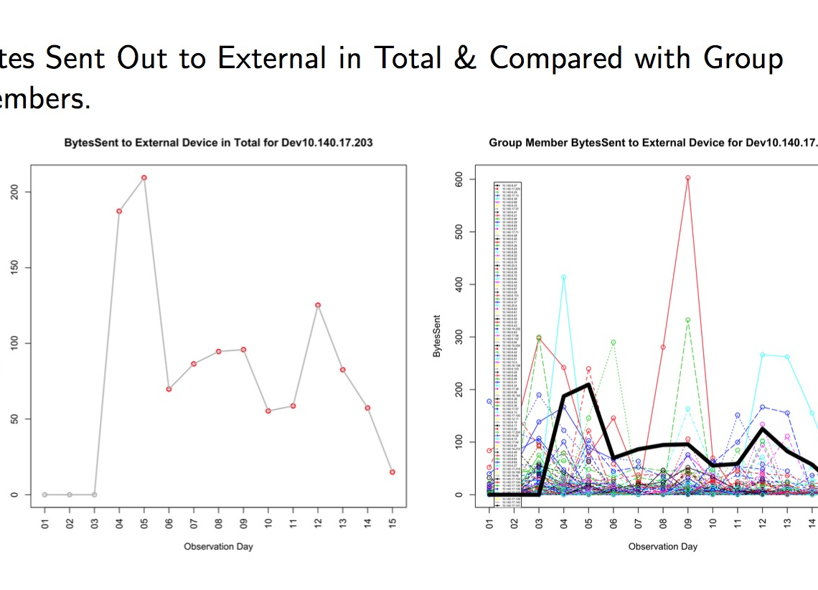
Comparing a Profile to a Group

Slide 53
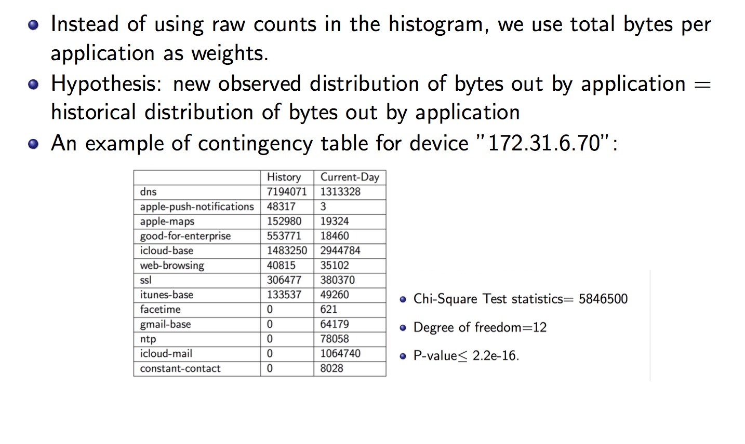
Application Fingerprints

Slide 54
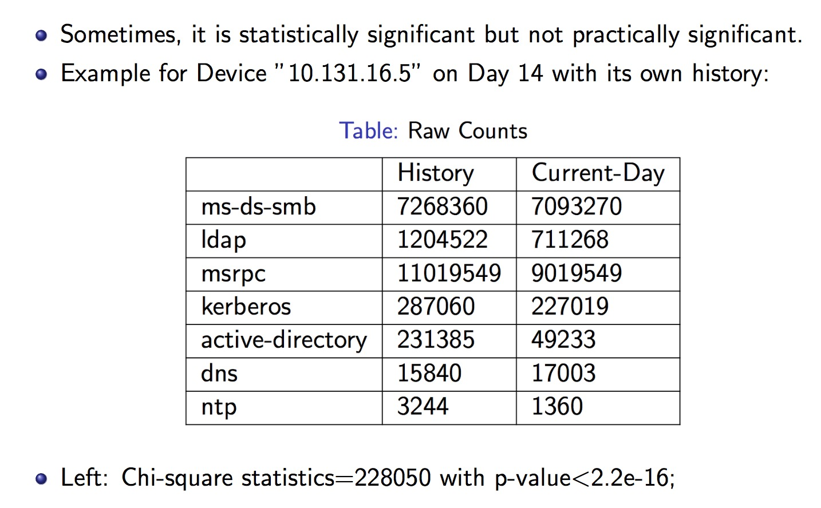
Layer 7 Info
Not always possible to build these kind of statistics without higher layer application data or PCAPs

Slide 55
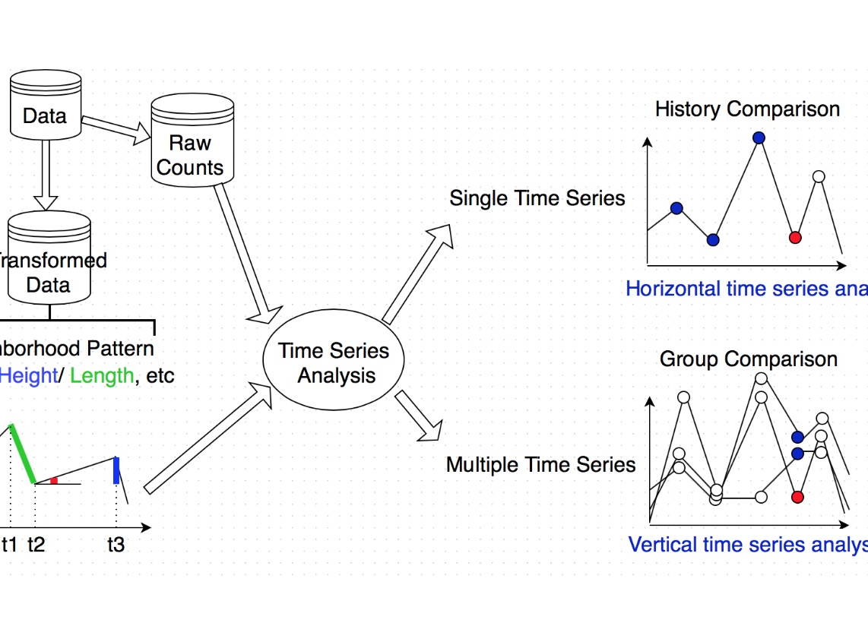
ML/Stat Workflow Engine

Slide 56
STEP 4: Client/Server Relation Discovery

Slide 57
Its all in the Bytes
Depending on what type of visibility you have you can leverage certain levels of granularity
Flows (Netflow v 7) you get number of packets per flow very important
PCAPS best case scenario but hard to log/process at scale for large environments
Higher layers might get a loss of signal

Slide 58
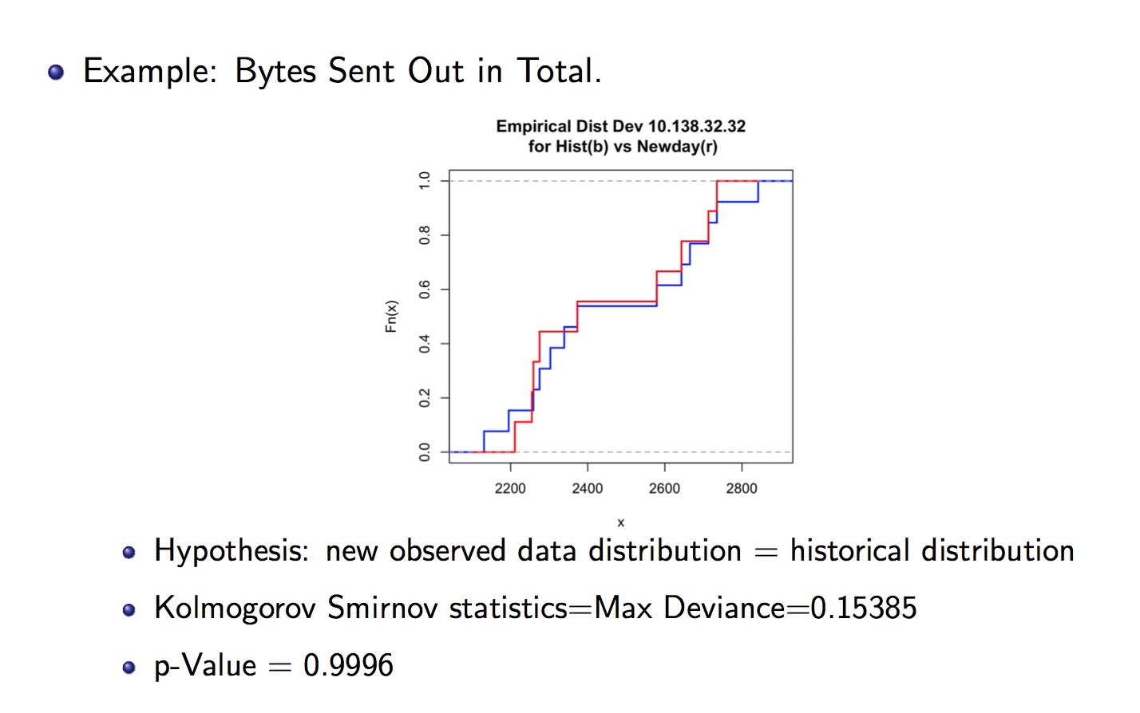

Slide 59
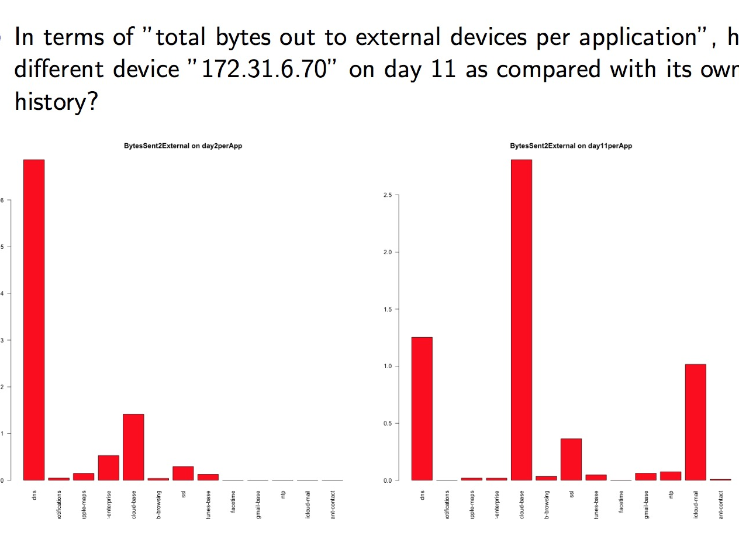
Histogram of Byte Distribution

Slide 60
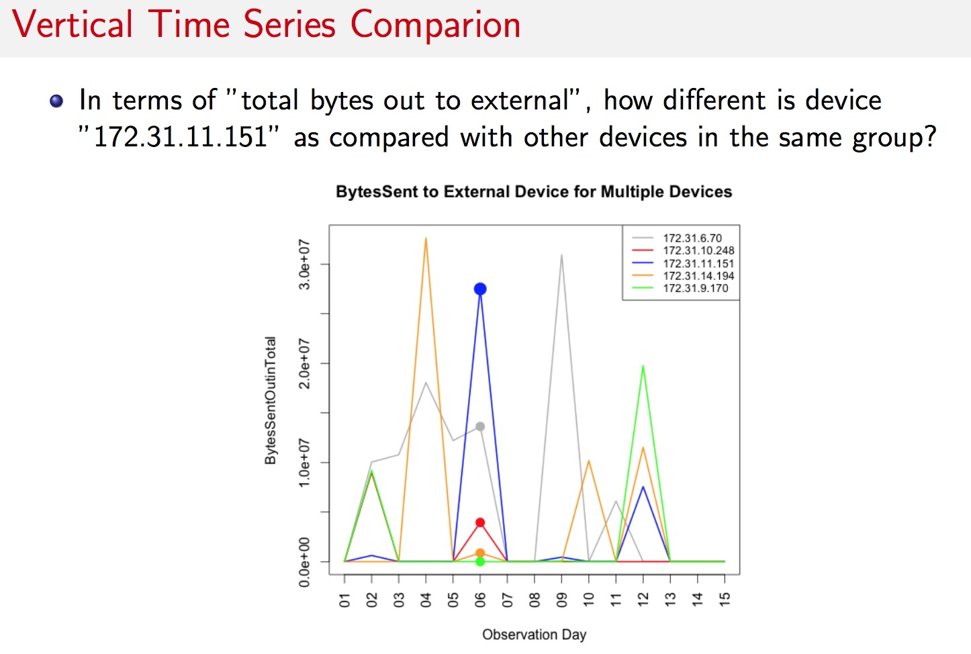
Group Based Comparisons

Slide 61
STEP 5: Monitor for changes in asset relationship graph
“At this point all the hard work is done”…

Slide 62
Mining For Relationship Anomalies
Anomalies on rare paths
U->S
S->U !!
U->U (LAN to LAN)
S->S (DMZ to LAN)!!
DMZ Server
LAN Asset
Desktop
Server
Desktop
Laptop

Slide 63
Beyond the Indicator
Webshell
DMZ to LAN Trust

Slide 64
Seeing the Analytic In Action

Slide 65
Seeing the Analytic In Action

Slide 66
Seeing the Analytic In Action
Once identity resolution/learning process is complete we create new anomalies based on new paths/actions that are rare for a particular population profiel
Lightweight Webshell in the DMZ

Slide 67
Conclusion - Rod - Joe
New approaches in machine learning and data science can help improve lateral movement detection.
Establish behavioral patterns based on data driven approaches can provide tools for detecting and predicting unusual, high risk and malicious behavior patterns in users and use of assets.
We have been successful catching webshells and new kinds of in memory malware using the rare path approach
U->S
S->U !!
U->U (LAN to LAN)
S->S (DMZ to LAN)!!

Slide 68
Q&A
Thank you
Rod Soto @rodsoto
Joseph Zadeh @josephzadeh

Slide 69
Appendix

Slide 70
Cybersecurity Analytics: ROIv1

Slide 71
Cybersecurity Analytics: ROIv1
WAN
LAN

Slide 72

Cybersecurity Analytics: ROIv1
Best Short Term “ROI”
WAN
LAN

Slide 73
Key to ML: Label Your Analysis
This is how the algorithms will “learn” from human expertise and help support a common security workflow
Domain Name | TotalCnt | RiskFactor | AGD | SessionTime | RefEntropy | NullUa | Outcome
yyfaimjmocdu.com | 144 | 6.05 | 1 | 1 | 0 | 0 | Malicious
jjeyd2u37an30.com | 6192 | 5.05 | 0 | 1 | 0 | 0 | Malicious
cdn4s.steelhousemedia.com | 107 | 3 | 0 | 0 | 0 | 0 | Benign
log.tagcade.com | 111 | 2 | 0 | 1 | 0 | 0 | Benign
go.vidprocess.com | 170 | 2 | 0 | 0 | 0 | 0 | Benign
statse.webtrendslive.com | 310 | 2 | 0 | 1 | 0 | 0 | Benign
cdn4s.steelhousemedia.com | 107 | 1 | 0 | 0 | 0 | 0 | Benign
log.tagcade.com | 111 | 1 | 0 | 1 | 0 | 0 | Benign
Human Expertise is manually encoded into a format computers understand: Sometimes this process is called Labeling or “Truth-ing” the data

Slide 74
Lambda Architecture
Architecture is described by three simple equations:
batch view = function(all data)
realtime view = function(realtime view, new data)
query = function(batch view, realtime view)

Slide 75


Lambda Security
DHCP
IMS/IPAM
FW
AD
VPN
Proxy
Data Ingest

Slide 76

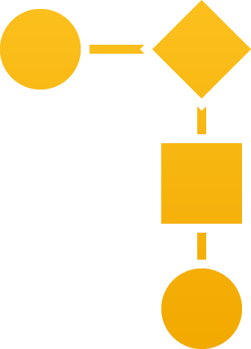
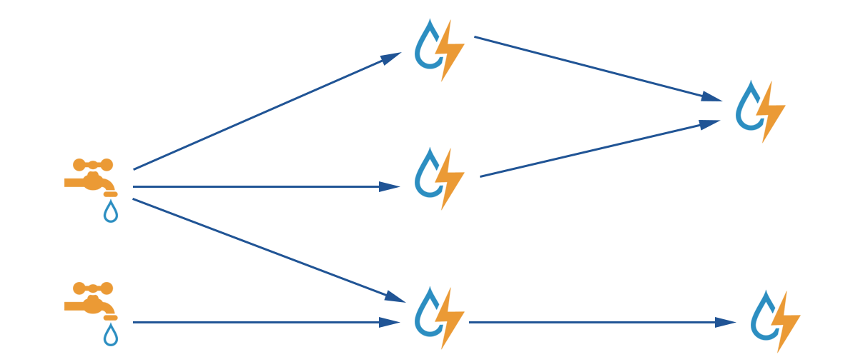
Lambda Security
Real Time Layer
DHCP
Real Time Identity Resolution
Sequential Models and IOC’s
IP | DHCP.MAC | DHCP_Lasteventtime | AD_FQDN
10.100.1.23 | 58:5c:35:c3:6e:a4 | 2014-03-11T14:00:00 | joe.eng.acme.com
10.13.11.221 | 12:3a:74:b2:6a:22 | 2014-03-12T14:30:00 | ad.hr.acme.com
IMS/IPAM
AD
Username = select coallesce(user_name, hostname, IP) from Active_ID_Table where IP = ‘10.10.100.23)
FW
Distributed ETL
VPN
Proxy
Data Ingest

Slide 77
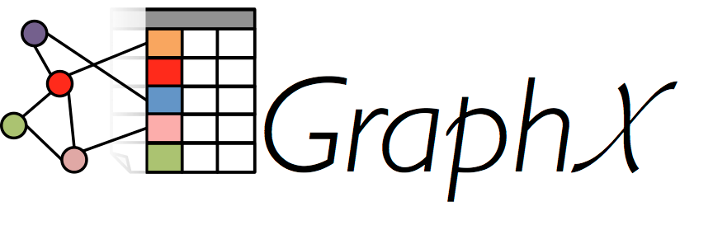



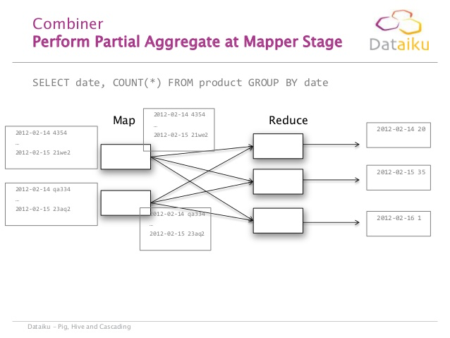
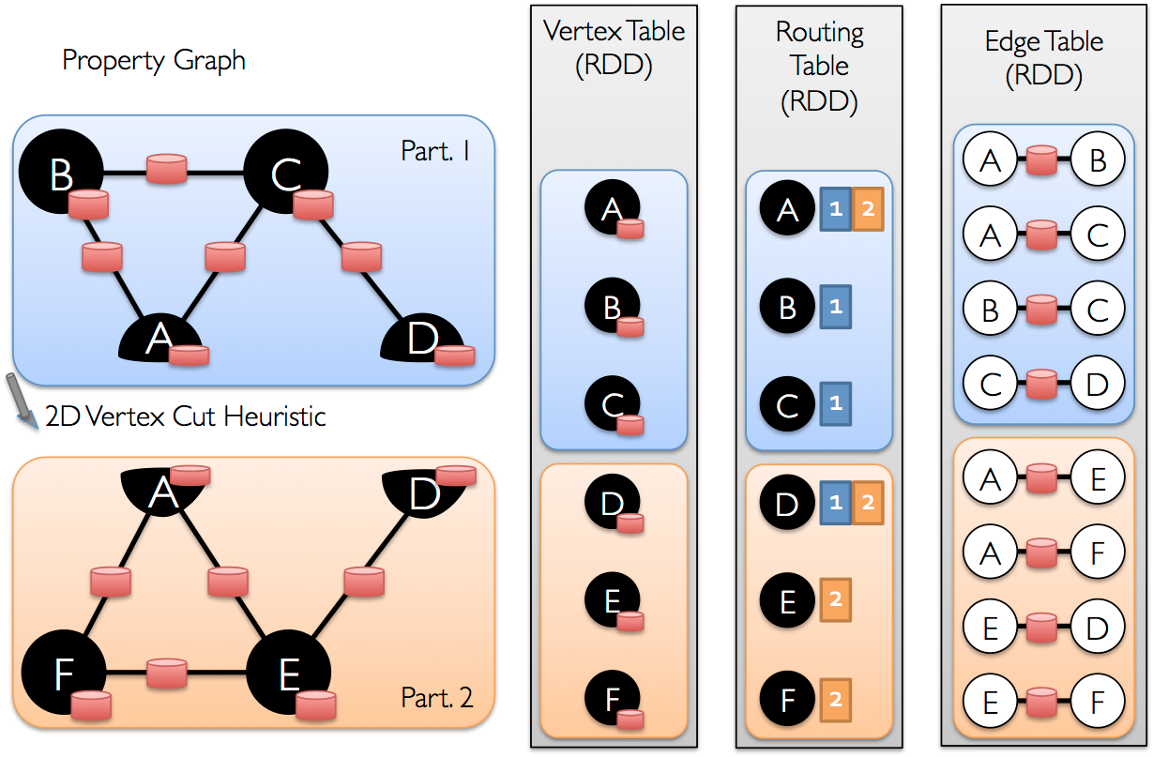
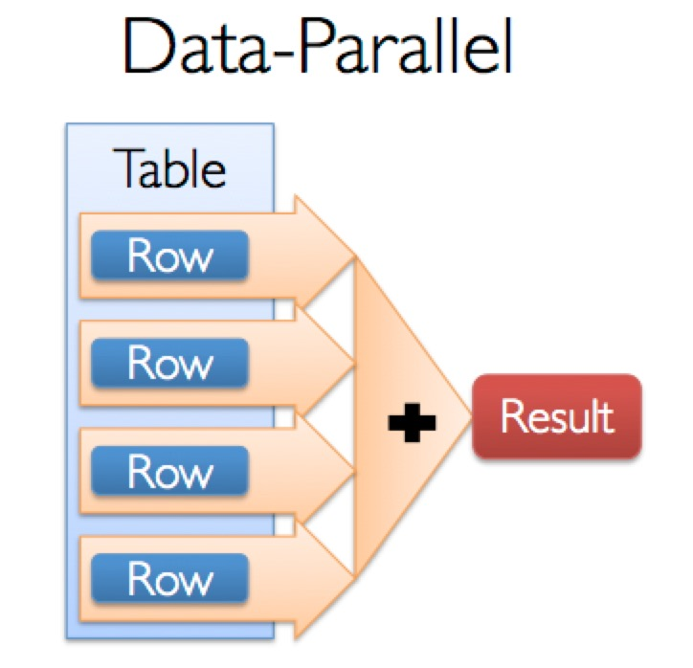

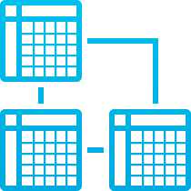

Lambda Security
Real Time Layer
DHCP
Real Time Identity Resolution
Sequential Models and IOC’s
IP | DHCP.MAC | DHCP_Lasteventtime | AD_FQDN
10.100.1.23 | 58:5c:35:c3:6e:a4 | 2014-03-11T14:00:00 | joe.eng.acme.com
10.13.11.221 | 12:3a:74:b2:6a:22 | 2014-03-12T14:30:00 | ad.hr.acme.com
IMS/IPAM
AD
Username = select coallesce(user_name, hostname, IP) from Active_ID_Table where IP = ‘10.10.100.23)
FW
Distributed ETL
VPN
Proxy
Data Ingest
Large Scale Models and Non-Sequential IOC’s
Batch Layer

Slide 78


Lambda Security
Real Time Layer
DHCP
Real Time Identity Resolution
Sequential Models and IOC’s
IP | DHCP.MAC | DHCP_Lasteventtime | AD_FQDN
10.100.1.23 | 58:5c:35:c3:6e:a4 | 2014-03-11T14:00:00 | joe.eng.acme.com
10.13.11.221 | 12:3a:74:b2:6a:22 | 2014-03-12T14:30:00 | ad.hr.acme.com
IMS/IPAM
Hybrid View (Batch + Real Time)
AD
Username = select coallesce(user_name, hostname, IP) from Active_ID_Table where IP = ‘10.10.100.23)
FW
Distributed ETL
VPN
Proxy
Data Ingest
Large Scale Models and Non-Sequential IOC’s
Batch Layer

Slide 79
DHCP
Real Time Identity Resolution
Sequential Models and IOC’s
IP | DHCP.MAC | DHCP_Lasteventtime | AD_FQDN
10.100.1.23 | 58:5c:35:c3:6e:a4 | 2014-03-11T14:00:00 | joe.eng.acme.com
10.13.11.221 | 12:3a:74:b2:6a:22 | 2014-03-12T14:30:00 | ad.hr.acme.com
IMS/IPAM
Hybrid View (Batch + Real Time)
AD
Username = select coallesce(user_name, hostname, IP) from Active_ID_Table where IP = ‘10.10.100.23)
FW
Distributed ETL
VPN
Proxy
Data Ingest
Large Scale Models and Non-Sequential IOC’s

Slide 80
Automated process to accelerate workflows like Splunk Query to retrieve PCAP for further analysis combined with automatic VT/heuristic correlations
DHCP
Real Time Identity Resolution
Sequential Models and IOC’s
IP | DHCP.MAC | DHCP_Lasteventtime | AD_FQDN
10.100.1.23 | 58:5c:35:c3:6e:a4 | 2014-03-11T14:00:00 | joe.eng.acme.com
10.13.11.221 | 12:3a:74:b2:6a:22 | 2014-03-12T14:30:00 | ad.hr.acme.com
IMS/IPAM
Hybrid View (Batch + Real Time)
AD
Username = select coallesce(user_name, hostname, IP) from Active_ID_Table where IP = ‘10.10.100.23)
FW
Distributed ETL
VPN
Proxy
Data Ingest
Large Scale Models and Non-Sequential IOC’s

Slide 81
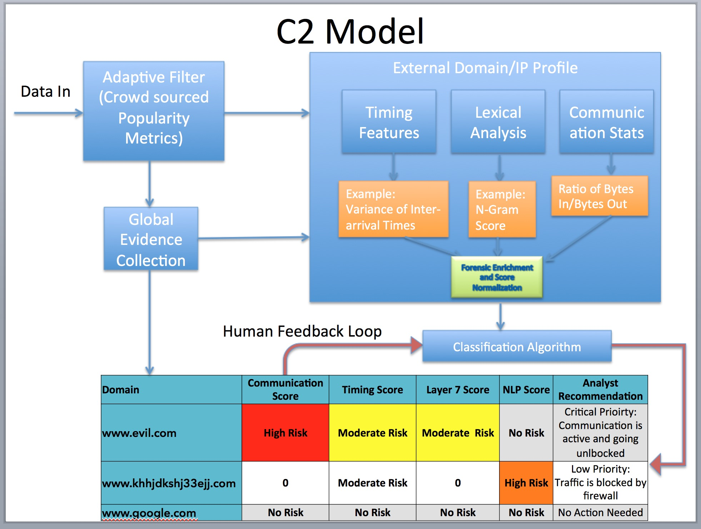



ML + Sequencing the Security DNA
We parallelize across many nodes (JVMs) and use both real time and batch computations
JVM 1
GET http://forbes.com/gels-contrariness-domain-punchable/"
GET http://portcullisesposturen.europartsplus.org/
POST http://dpckd2ftmf7lelsa.jjeyd2u37an30.com/
JVM 2
GET http://youtube.com/
GET http://avazudsp.net/
GET http://betradar.com/
GET http://displaymarketplace.com/
JVM 3
GET http:/clickable.net/
GET http://vuiviet.vn/
GET http://homedepotemail.com/
GET http://css-tricks.com/

Slide 82
Time t_0
Command and Control (C2) traffic has been established between “Beachead” and command and control operator

Slide 83
Time t_0
Heartbeat traffic signals C2 operator that infected asset is up and ready for instructions

Slide 84
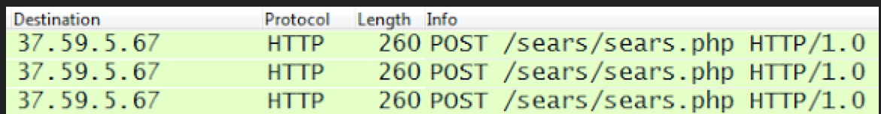
Time t_1
Obfuscated instructions get returned through an Upstream conversation embedded in PHP, .js, Flash, etc..
Commands obfuscated in this way can be through of as a hidden “Downstream Beacon”

Slide 85
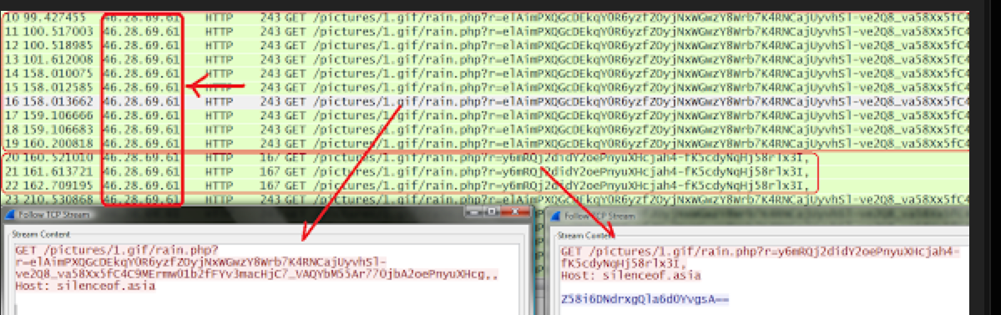
Embedded commands can signal infected asset to enumerate local information on the machine, attach to open network shares and perform lateral reconnaissance and privilege escalation throughout the compromised network
Time t_2

Slide 86
After targeted lateral movement and privilege enumeration all cases of targeted attacks eventually involve the compromise of the directory services roots servers (Usually AD Forest Roots) and exfiltration of key personnel information along with any
Time t_n

Slide 87
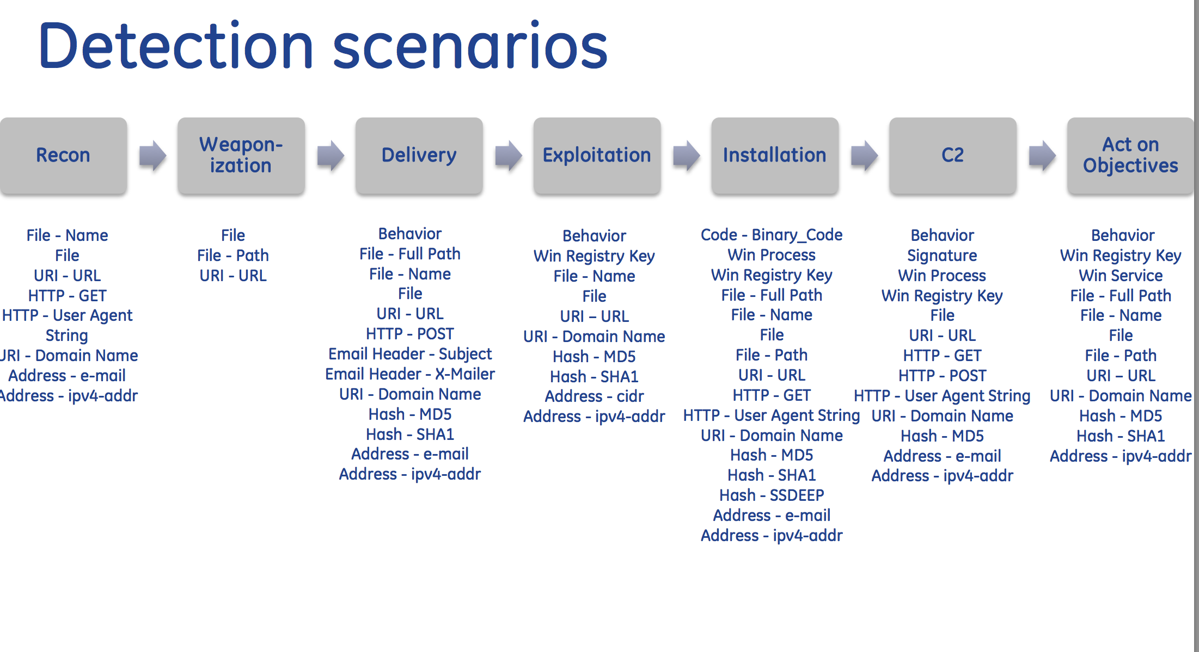
Edge weights can be encoded with key security features to increase overall model accuracy regardless of the underlying algorithms
BFS/DFS + Other classic graph search algorithms are a great examples of algorithms useful in detecting this graph signature

Slide 88
How can we automate discovery and data aggregation of DMZ assets - Joe

Slide 89
Proof of Concept / Example – Joe - Rod

Slide 90
Explanation of data science tools and techniques used for analysis – Joe

Slide 91
How can this be applied to layer 4/7 data or PCAP data - Joe

Slide 92
Time t_0
IP: 66.253.41.67
Command and Control (C2) traffic has been established between compromised hosts inside the corporate network and C2 servers

Slide 93
Time t_0
IP: 66.253.41.67
Command and Control (C2) traffic has been established between compromised hosts inside the corporate network and C2 servers

Slide 94
Time t_1
IP: 47.99.1.63
C2 Infrastructure changes locations of command and control server new communication path is established

Slide 95
Time t_1
IP: 47.99.1.63
C2 Infrastructure changes locations of command and control server new communication path is established

Slide 96
Time t_2
IP: 210.2.13.22
http://en.wikipedia.org/wiki/Fast_flux: Fast flux is a DNS technique used by botnets to hide phishing and malware delivery sites behind an ever-changing network of compromised hosts acting as proxies. It can also refer to the combination of peer-to-peer networking, distributed command and control, web-based load balancing and proxy redirection used to make malware networks more resistant to discovery and counter-measures. The Storm Worm is one of the recent malware variants to make use of this technique.

Slide 97
Time t_2
IP: 210.2.13.22
At each time step (typically a day or two) the C2 Infrastructure changes locations of command and control via this “Fluxing” behavior. A subset of these type of graph patterns is known as “Fast Fluxing”

Slide 98
The constant mobility of command and control infrastructure will continue this IP/Domain fluxing movement until detected
Time t_n
IP: 82.21.4.6

Slide 99
The constant mobility of command and control infrastructure will continue this IP/Domain fluxing movement until detected
Time t_n
IP: 82.21.4.6

